Slide 1
Intro To Programming JavaScript

Slide 2
Brief Summary Of Chapter 5
A full HTML Document
What is HTML
Tags and Elements
Chapter 5: The Basics of HTML

Slide 3
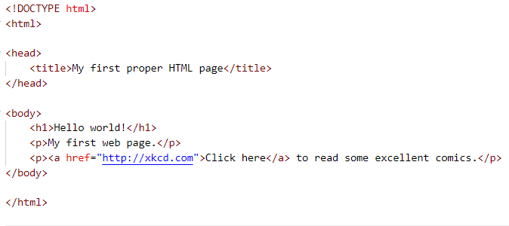
(B-p112 - 113 & L-p85 - 86)
A full HTML Document

Slide 4
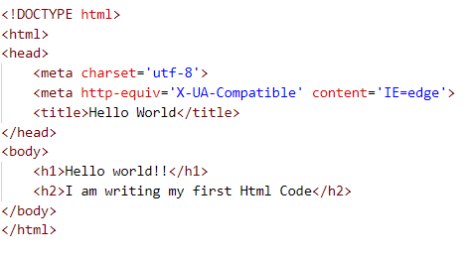
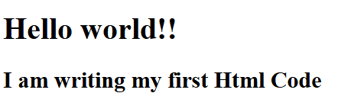
HTML (HyperText Markup Language) is the standard language used to create and structure content on the web. It uses a system of tags, called markup, to define elements like headings, paragraphs, links, and images, giving meaning and organization to a webpage. The "HyperText" part refers to the use of hyperlinks that connect different pages or sections, allowing users to navigate the web easily. HTML forms the foundation of every website, working alongside CSS for styling and JavaScript for dynamic behavior.
What is HTML?

Slide 5
Tags are crucial because they give structure and meaning to your content. Without tags, a webpage would just be one big block of text — no headings, no formatting, no organization.
Using the right tags helps browsers display content properly and makes your site more accessible and readable for users (and search engines too!).
Tags are the building blocks of HTML. They are used to mark up content and structure a webpage. Tags are enclosed in angle brackets, like < >. For example:
<p> is a tag used to define a paragraph
<h1> is a tag used to define a heading
An HTML element consists of three parts: a start tag, some content, and an end tag. Here's a simple example:
<p>This is a paragraph.</p>
<h1>First-level heading</h1>
Tags and Elements

Slide 6
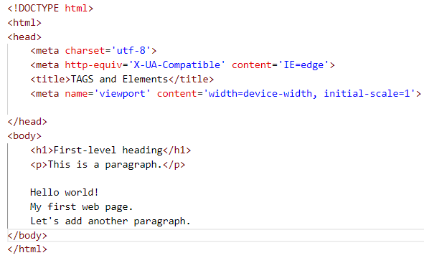
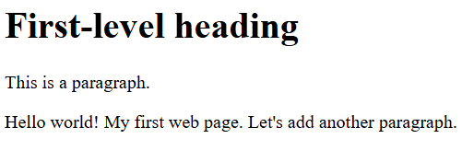
What would our page look like with and without the tags: (B-p108 & L-p81)

Slide 7
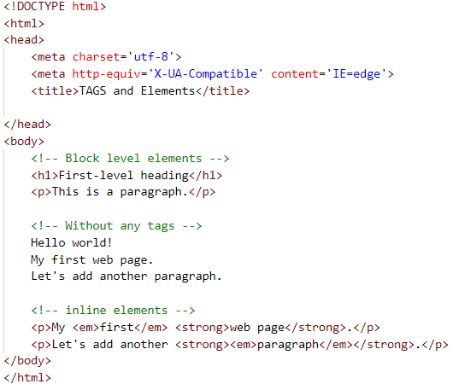
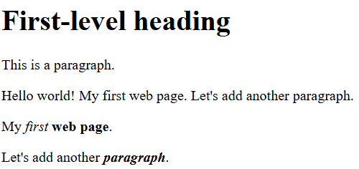
Inline Elements B-p109 & L-p82
The em element makes its content italic.
The strong element makes its content bold.
The em and strong elements are both inline elements, which means that they don’t put their content onto a new line, as block-level elements do.
Block level elements and inline elements: https://www.w3schools.com/html/html_blocks.asp

Slide 8

Do the try outs then upload to github.
Page (B-115 & L-88)
Practice Exercises

Slide 9
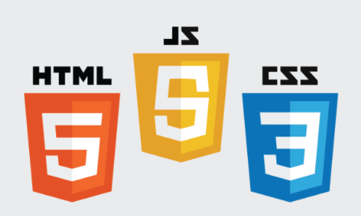
End Of Chapter 5

